Slide 1
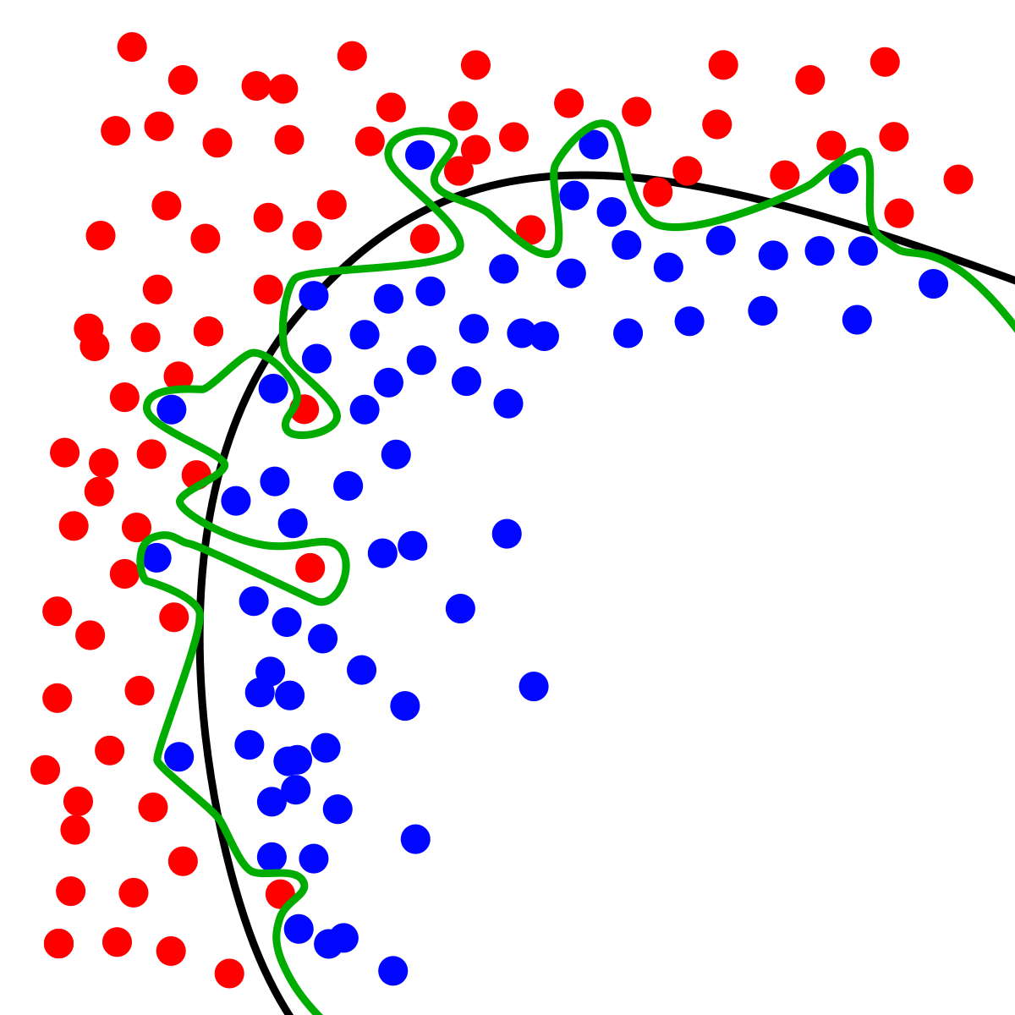
Dynamic Systems Thinking for Psychologists
Michael E. Aristodemou
michael.aristodemou@psychologie.uzh.ch
Lecture 10: A case study for applying dynamic systems

Slide 2
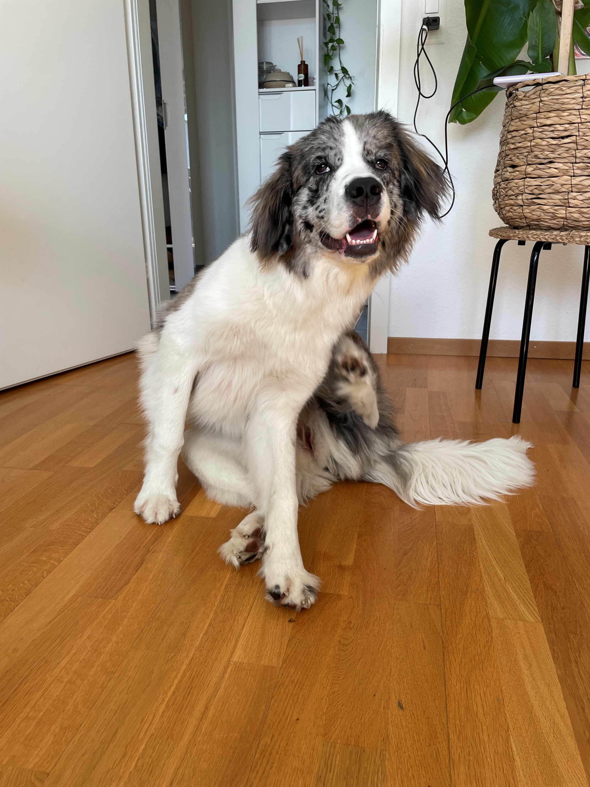
Is this elimination trial worthwhile?
Story: Meet Kirki, my dog, who has been scratching compulsively and has irritated (red) skin. I call a vet over who takes a look at her and tells me that this looks like an allergic reaction, which 80% of the time is a response to some proteins. So, she needs to get on an elimination diet to get rid of the allergens. I buy this (very expensive) food and start Kirki on her new diet. She happily eats it (she will eat just about anything). But a week later, I notice that her itch gets worse and her skin is even more irritated. Just as I’m thinking of calling the vet, Kirki happily places her snout on the couch and drops a flower petal. I go out to the balcony and notice that she’s been secretly snacking on the lavender plant! Which is toxic for dogs (can cause skin irriation, itching etc.). So, then I remove the lavender plant and continue the diet. But while walking Kirki, I notice that a dog owner throws snacks on the ground to incentivize their old dog to move during their walks. Of course, Kirki has at times been indulging in these free snacks during our walks.
Decision: I need to decide whether I can trust the results of this elimination diet. The diet evaluation deadline is due in a week.

Slide 3
Take 5 minutes to read and make some notes
Github → case_kirki.txt
Main variables
Timeline
Main goal

Slide 4
In-class walkthrough

Slide 5
Let’s start with a simple model
What is the primary question that we want to answer?
What do we need to know to answer this question?

Slide 6
Evaluating an ideal elimination diet
Step 1: Choose necessary variables
1.
2.

Slide 7
Evaluating an ideal elimination diet
Choose necessary variables:
1. Allergen count
2. Protein input
Protein input
Allergen count

Slide 8
Evaluating an ideal elimination diet
Choose necessary shocks/interventions:
1.
2.
Protein input
Allergen count

Slide 9
Evaluating an ideal elimination diet
Choose necessary shocks/interventions:
1.
2.
Protein input
Allergen count

Slide 10
Evaluating an ideal elimination diet
Choose necessary shocks/interventions:
1. Protein food
2. Elimination diet
Elimination diet
Protein food
Protein input
Allergen count

Slide 11
Think of each element as a process
Elimination diet
A continuous variable (takes values of any real number). It’s rate of change depends on its own state (natural decay of allergens) and the amount of protein input at each instant.
Protein food
Protein input
Allergen count

Slide 12
Think of each element as a process
Elimination diet
A continuous variable (takes values of any real number). It’s rate of change depends on its own state (natural decay of allergens) and the amount of protein input at each instant.
Protein food
Protein input
Allergen count
A continuous variable (takes values of any real number). It’s rate of change is completely driven by external shocks. It keeps the state given by the most recent shocks (A = 0).

Slide 13
Think of each element as a process
Elimination diet
A continuous variable (takes values of any real number). It’s rate of change depends on its own state (natural decay of allergens) and the amount of protein input at each instant.
Protein food
Protein input
Allergen count
A binary variable (0,1). Is 1 on the first occasion and 0 on all other occasions.
A continuous variable (takes values of any real number). It’s rate of change is completely driven by external shocks. It keeps the state given by the most recent shocks (A = 0).

Slide 14
Think of each element as a process
A binary variable (0,1). Is 1 on when the elimination diet start and 0 on all other occasions.
Elimination diet
A continuous variable (takes values of any real number). It’s rate of change depends on its own state (natural decay of allergens) and the amount of protein input at each instant.
Protein food
Protein input
Allergen count
A binary variable (0,1). Is 1 on the first occasion and 0 on all other occasions.
A continuous variable (takes values of any real number). It’s rate of change is completely driven by external shocks. It keeps the state given by the most recent shocks (A = 0).

Slide 15
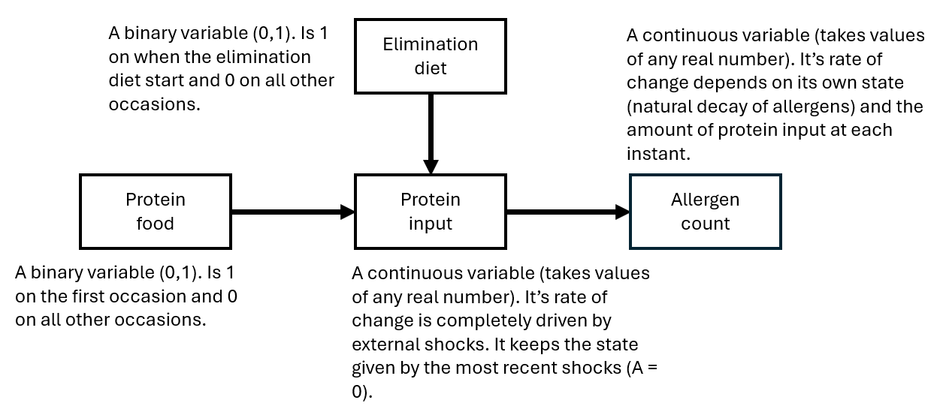
Formalize this process
$$Allergen_{t+1}=Allergen_{t}+dAllergen_{t}$$
$$dAllergen_{t}={(A}_{1}∗Allergen_{t}+ProteinInput_{t})dt$$
$$Protein_{t+1}=Protein_{t}+dProtein_{t}$$
$$dProtein_{t}=(0∗Protein_{t}+ProteinFood_{t}+EliminationDiet_{t})dt$$

Slide 16
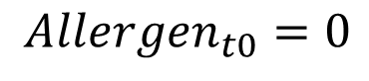
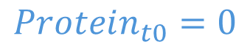
Initializing the process
$$Allergen_{t+1}=Allergen_{t}+dAllergen_{t}$$
$$dAllergen_{t}={(A}_{1}∗Allergen_{t}+Protein_{t})dt$$
$$Protein_{t+1}=Protein_{t}+dProtein_{t}$$
$$dProtein_{t}=(0∗Protein_{t}+ProteinFood_{t}−EliminationDiet_{t})dt$$
$$Protein_{t0}=0$$
$$Allergen_{t0}=0$$

Slide 17
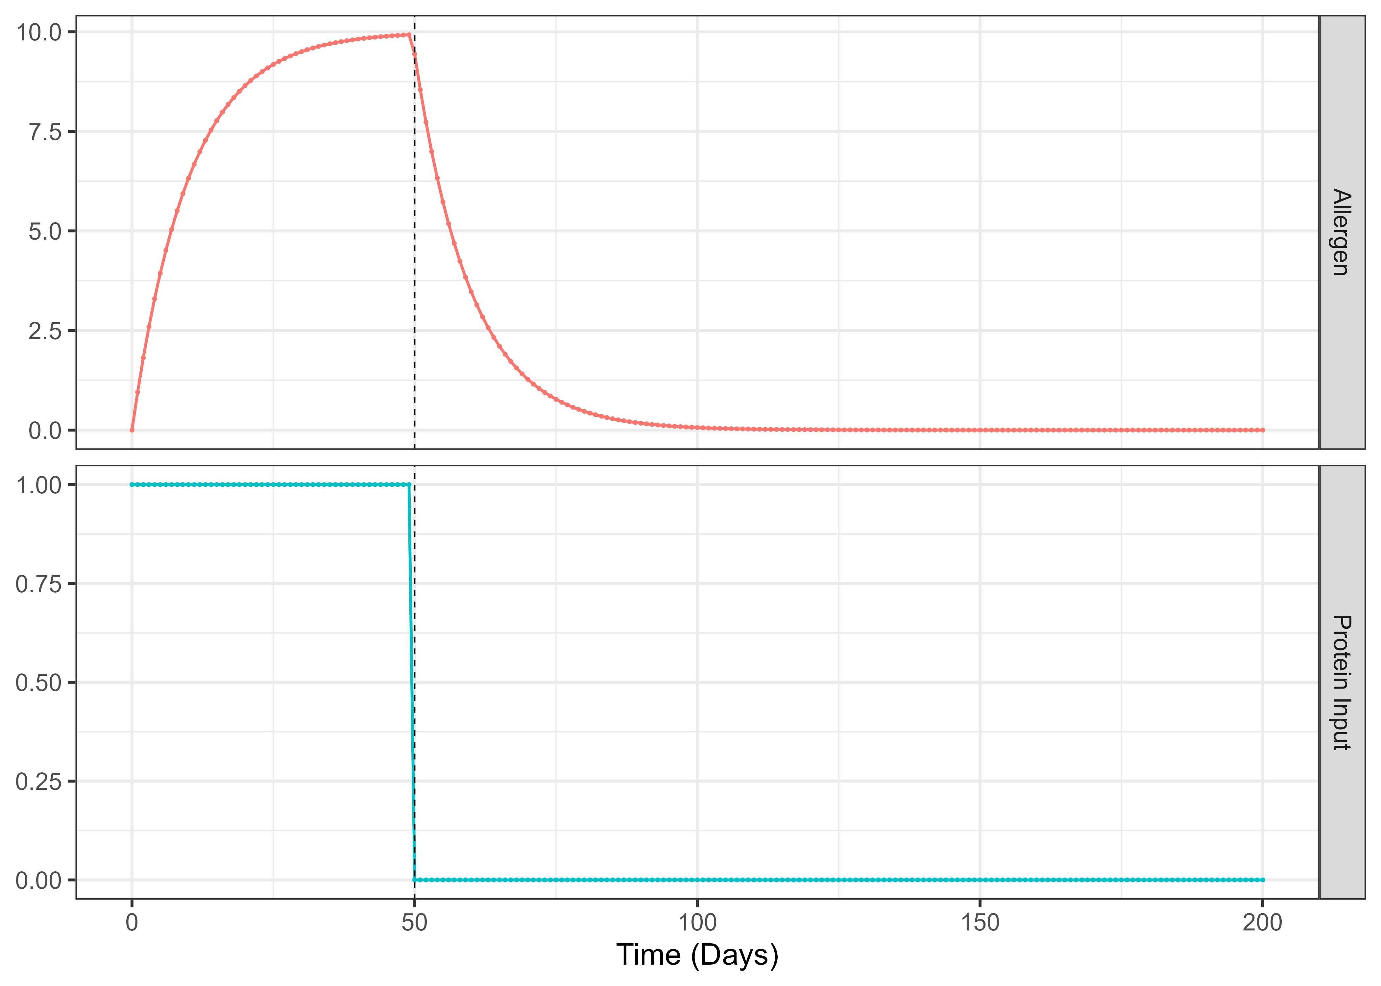
Visualizing the elimination trial under ideal conditions

Slide 18
Adding more complexity: Kirki snacking on lavender
Elimination diet
Protein food
Protein input
Allergen count

Slide 19
Adding lavender eating
Lavender eating
Elimination diet
Lavender toxins
Protein food
Protein input
Allergen count

Slide 20
Adding lavender eating
A binary 0,1 variable. This takes the value 1 at the timepoint where the eating starts and 0 otherwise.
Lavender eating
Elimination diet
Lavender toxins
Protein food
Protein input
Allergen count

Slide 21
Adding lavender toxins
A binary 0,1 variable. This takes the value 1 at the timepoint where the eating starts and 0 otherwise.
Lavender eating
A continuous variable (takes on any real number). The value of the toxins slowly accumulates during the snacking period until I find out and remove the lavender. After this point the toxins rapidly decay.
Elimination diet
Lavender toxins
Protein food
Protein input
Allergen count

Slide 22
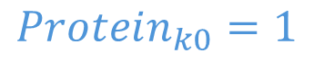
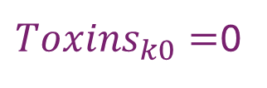
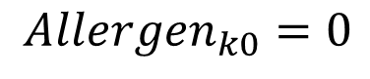
Formalizing the process
$$Allergen_{t+1}=Allergen_{t}+dAllergen_{t}$$
$$dAllergen_{t}={(A}_{1}∗Allergen_{t}+ProteinInput_{t}+Toxins_{t})dt$$
$$Protein_{t+1}=Protein_{t}+dProtein_{t}$$
$$dProtein_{t}=(0∗Protein_{t}+ProteinFood_{t}+EliminationDiet_{t})dt$$
$$Toxins_{t+1}=Toxins_{t}+dToxins_{t}$$
$$dToxins_{t}=A_{2}∗Toxins_{t}∗Stopping+LavenderInput_{t}$$
$Toxins_{k0}=$0
$$Protein_{k0}=1$$
$$Allergen_{k0}=0$$

Slide 23
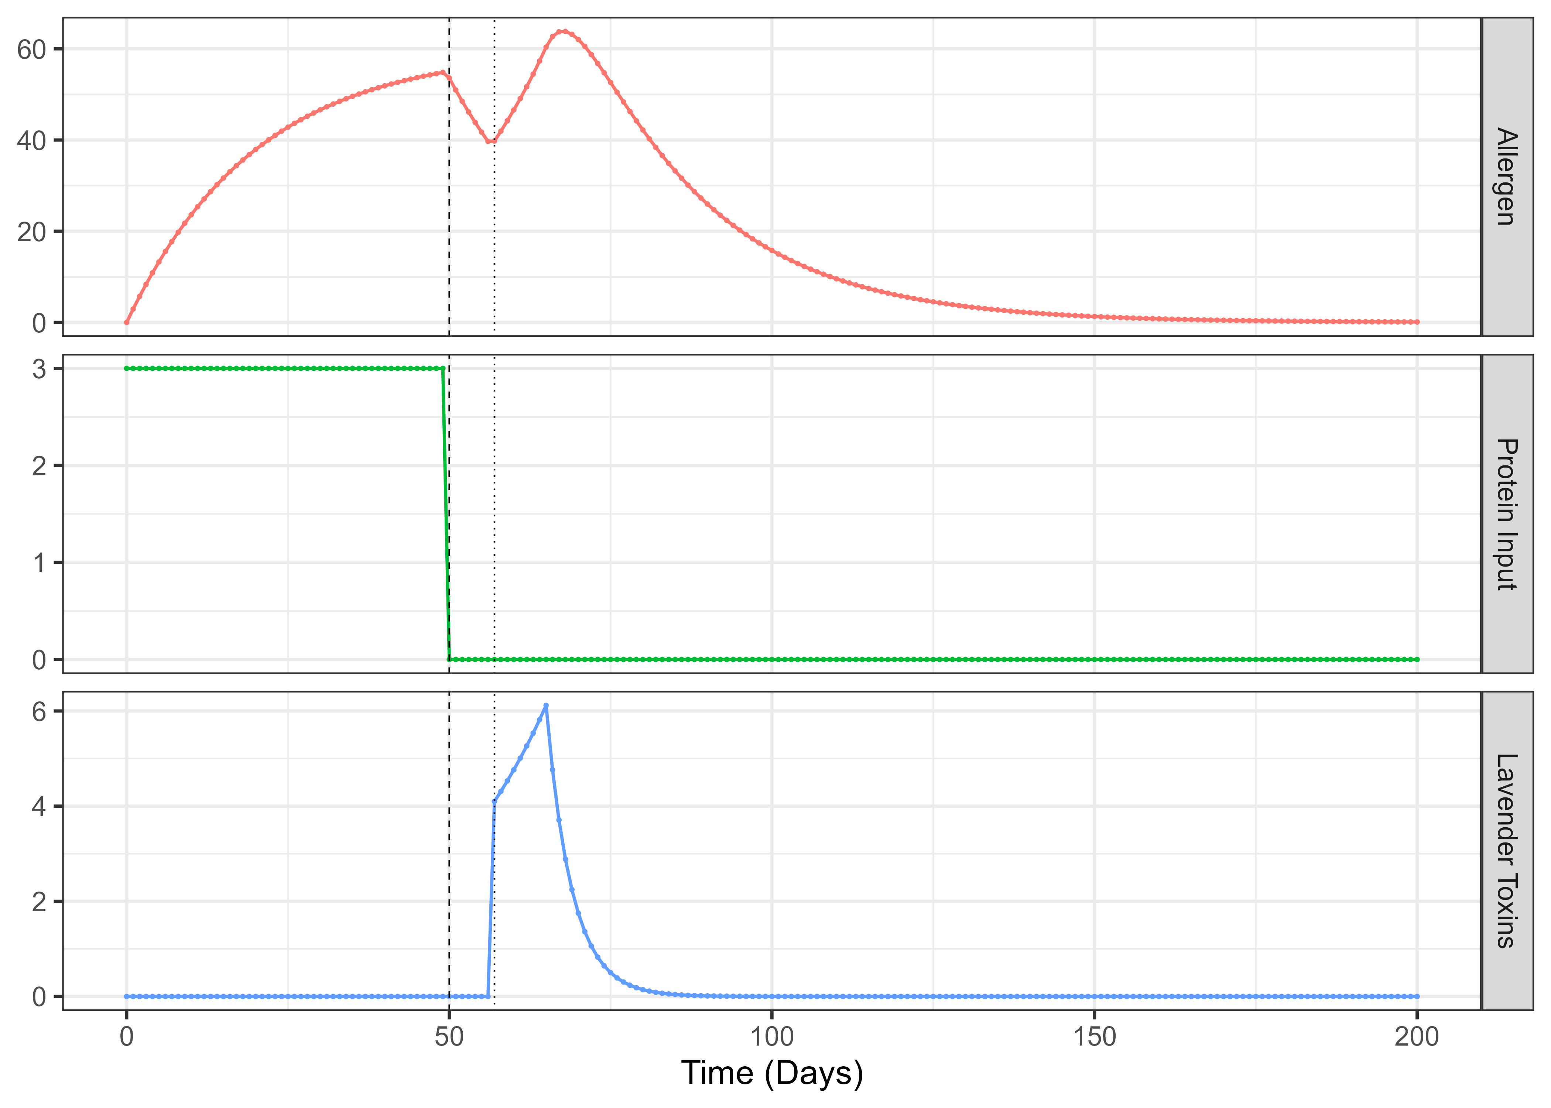
Visualizing the elimination trial with toxin effect added

Slide 24
Last layer of complexity: Kirki’s random snacking in the park
Lavender eating
Elimination diet
Lavender toxins
Protein food
Protein input
Allergen count

Slide 25
Last layer of complexity: Kirki’s random snacking in the park
Elimination diet
Lavender toxins
Lavender eating
Protein food
Protein input
Allergen count
A binary (0,1) variable. The value is 1 when snacking occurs, 0 when it does not. Snacking begins after the elimination diet.
Random snacking

Slide 26
Last layer of complexity: Kirki’s random snacking in the park
The rate of change in protein input changes to be the absorption rate of protein due to snacking, with an upper limit reflecting the max amount of protein due to a snacking day.
Elimination diet
Lavender toxins
Lavender eating
Protein food
Protein input
Allergen count
A binary (0,1) variable. The value is 1 when snacking occurs, 0 when it does not. Snacking begins after the elimination diet.
Random snacking

Slide 27
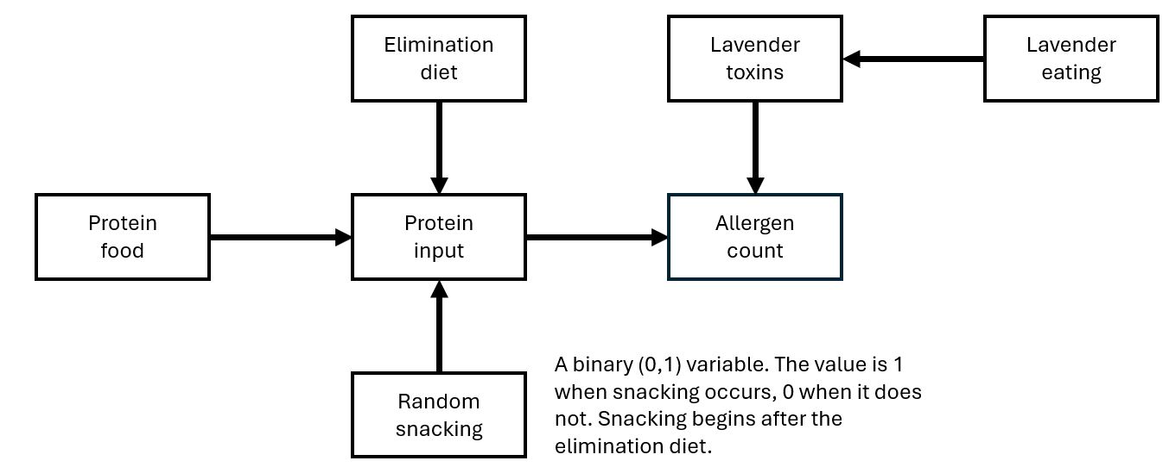
Formalize this process
$$Allergen_{t+1}=Allergen_{t}+dAllergen_{t}$$
$$dAllergen_{t}={(A}_{1}∗Allergen_{t}+ProteinInput_{t}+Toxins_{t})dt$$
$$Protein_{t+1}=Protein_{t}+dProtein_{t}$$
$$dProtein_{t}=(0∗Protein_{t}+ProteinFood_{t}+EliminationDiet_{t}+dSnack_{t})dt$$
$$dSnack_{t}=(k∗(A_{s}∗Snack_{t}−Protein_{t}))dt$$
$Toxins_{k0}=$0
$$Protein_{k0}=1$$
$$Allergen_{k0}=0$$

Slide 28
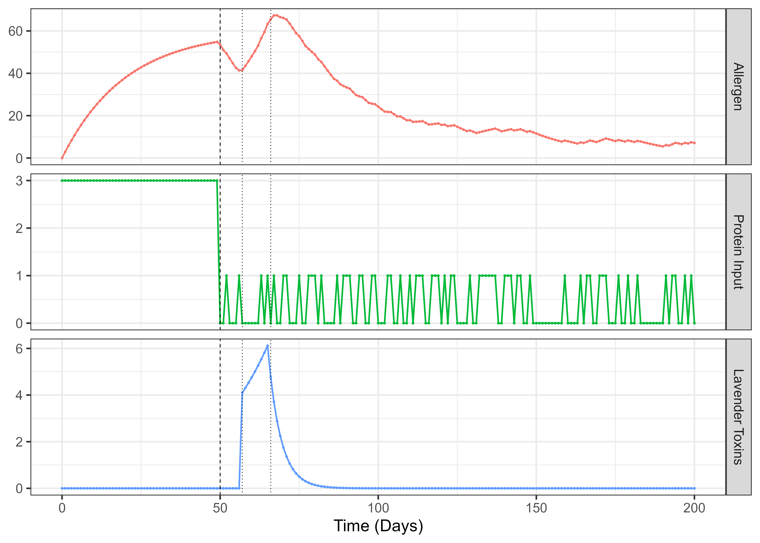
Visualizing the elimination trial with toxin and snacking added

Slide 29
From latents to observables
How can we observe this process?

Slide 30
Kirki’s behaviour
Did Kirki scratch today (yes/no)
Urge to scratch (continuous real number)

Slide 31
What observations our model generates
Elimination diet
Lavender toxins
Lavender eating
System Noise
Protein food
Protein input
Allergen count
Urge to scratch
Continuous variable, takes the value of any real number. Is driven by allergen count plus random shocks (system noise).
Random snacking

Slide 32
What observations our model generates
Elimination diet
Lavender toxins
Lavender eating
System Noise
Protein food
Protein input
Allergen count
Urge to scratch
Binary (0,1) variable. Takes a value of 1 on days when Kirki scratches, 0 otherwise. The probability of scratching is driven by urge to scratch.
Random snacking
Scratching

Slide 33
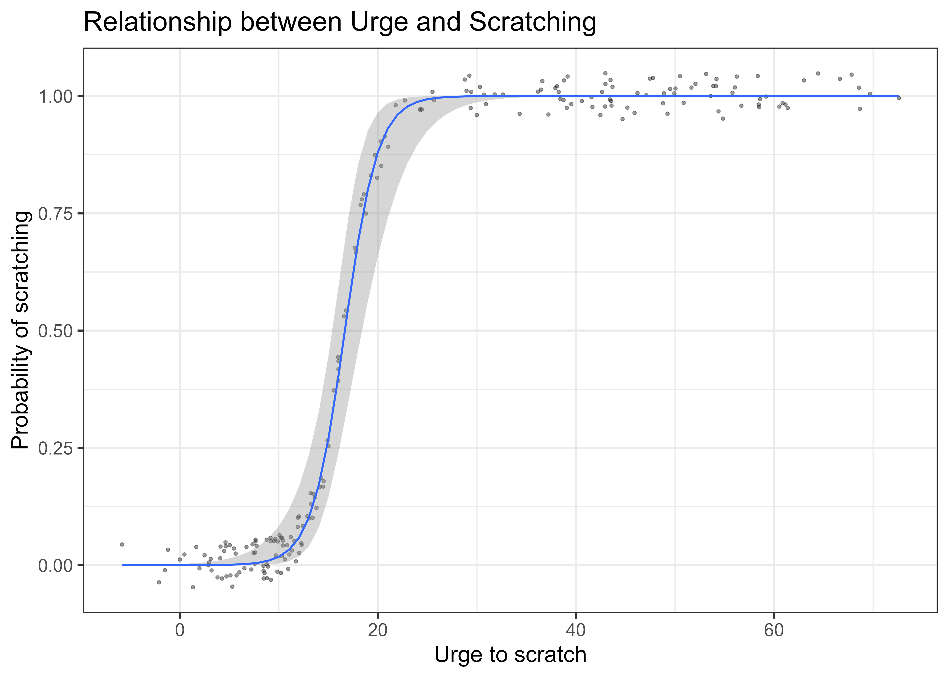
Relationship between urge and scratching

Slide 34
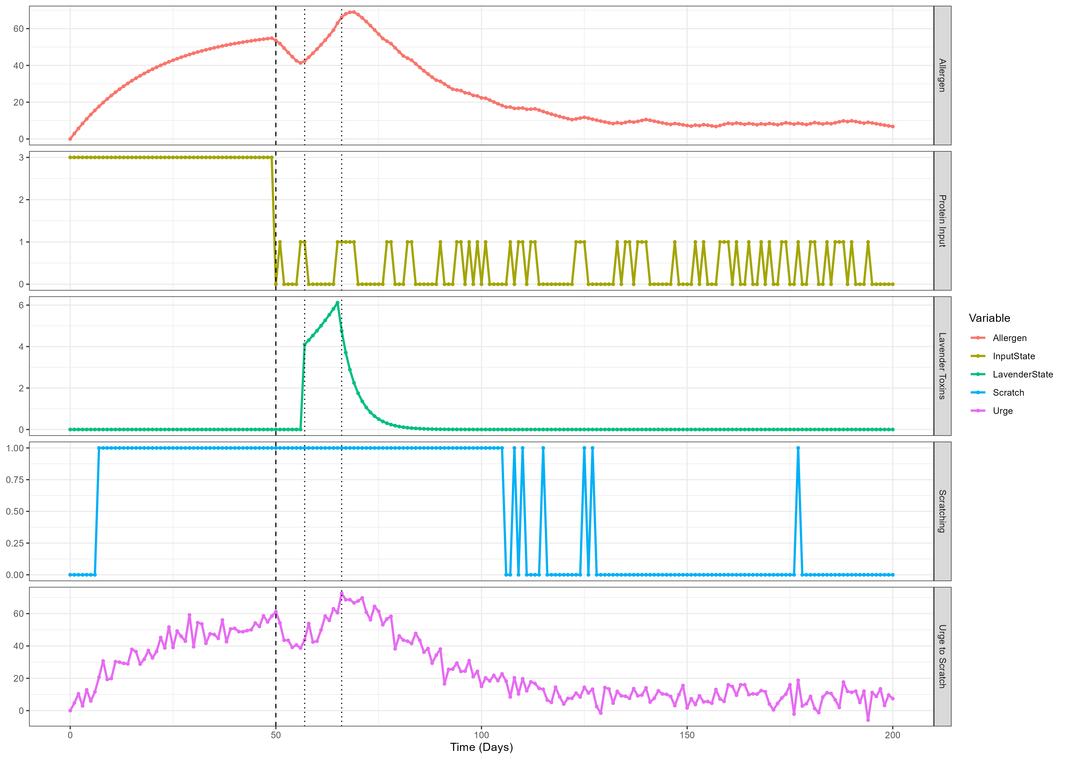
Visualizing the full process

Slide 35
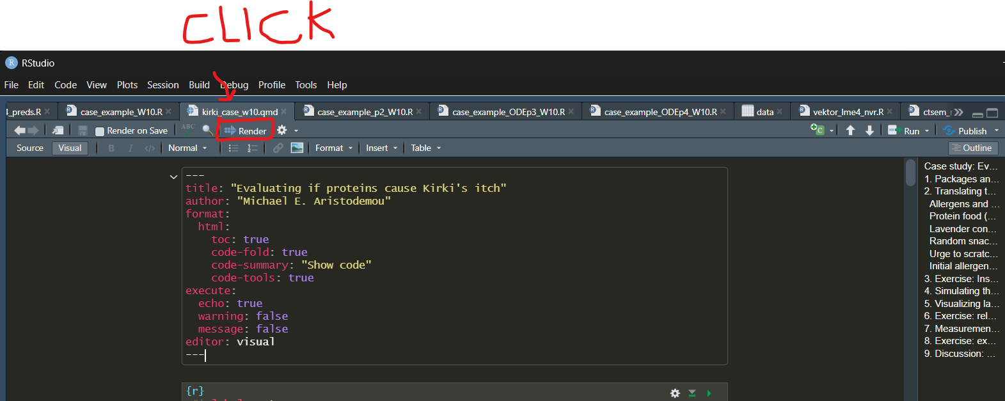
Learning through the case study
Think of which assumptions of the model are central to our conclusions (e.g. allergen decay rate)
Think of which assumptions are trivial
What measurements would help you fine-tune the model to make reliable inferences about the trustworthiness of the intervention?
There’s a file that can provide some guidance:
GitHub → kirki_case_10.qmd
Knit this file “→ Render” button to get an html file

Slide 36
Thank you for listening ૮ ºﻌºა

